Slide 1

Coding Best Practice in the NHSE SDE Cluster
Optimizing how we run code
Lars Murdock, Health Data Science Team
Notes:
This presentation is designed to offer a bit of context and advice to running code in the NHS England Secure Data Environment cluster.

Slide 2


Quick intro to the Cluster
Normal working
Cluster working
Notes:
For context, in your normal working environment you’ll be one person using the computation of one device e.g. your laptop – shown on the left-hand side. With cluster computing, you are instead commanding the computation of several devices – known as a cluster. So, when you run a long notebook of instructions, these can instead be broken up into smaller parts and run in parallel among this cluster.
This is why we need to use a slightly different language, one that can work out how to split up and spread out the work. This is why we use PySpark, SparkSQL or SparkR instead of python, sql and R.
For smaller datasets and simple operations, cluster computing might not be essential. For large datasets, such as the primary care or hospital records we can access in the SDE, this becomes essential.

Slide 3
Quick intro to the Cluster
Normal working
Cluster working
Notes:
It’s important to keep in mind we’re not the only one using the cluster. Across the consortium of researchers, we access the same cluster of computers.
This means that instead of normal working (one person – one device), we now have to figure out more responsible and considerate ways of working. We’ll discuss this more in this presentation.

Slide 4
Evolution of a Notebook…..
My notebook ……………………………………….. Code code code code code Code code code code code Code code code code code Code code code code code Code code code code code ………………………………………… ………………………………………...
My notebook ……………………………………….. Code code code code code Code code code code code Code code code code Code code code code Code code code code code Code code code code code Code code code code Code code code code code ………………………………………… ………………………………………...
My notebook ……………………………………….. Code code code code code Code code code code code Code code code code Code code code code Code code code code code Code code code code code Code code code code
Code code code Code code code code code
Code code code code
Code code code Code code code code code ………………………………………… ………………………………………...
My notebook ……………………………………….. Code code code code code Code code code code code Code code code code code Code code code code Code code code code Code code code code code Code code code code code Code code code code
Code code code Code code code code code
Code code code code
Code code code Code code code code code
Code code code code code Code code code code
Code code code Code code code code code ………………………………………… ………………………………………..................................................
Notes:
A bit of further context - more coding development can be illustrated as above.
Moving left to right, the notebook gradually gets longer and longer while more code (shown in different colours) is added.
Eventually we find ourselves with such a long notebook that it becomes unwieldy. It’s hard to fix errors, easy to lose track of which bits are responsible for what processes, and inefficient if we only need to run parts of it.

Slide 5
…into a series of notebooks…
My Notebook stage 1 ……………………………………….. Code code code code code Code code code code code Code code code code code Code code code code code Code code code code code ………………………………………… ………………………………………...
My Notebook stage 2 ……………………………………….. Code code code code code Code code code code code Code code code code code Code code code code code Code code code code code ………………………………………… ………………………………………...
My Notebook stage 3 ……………………………………….. Code code code code code Code code code code code Code code code code code Code code code code code Code code code code code ………………………………………… ………………………………………...
My Notebook stage 4 ……………………………………….. Code code code code code Code code code code code Code code code code code Code code code code code Code code code code code ………………………………………… ………………………………………...

Slide 6
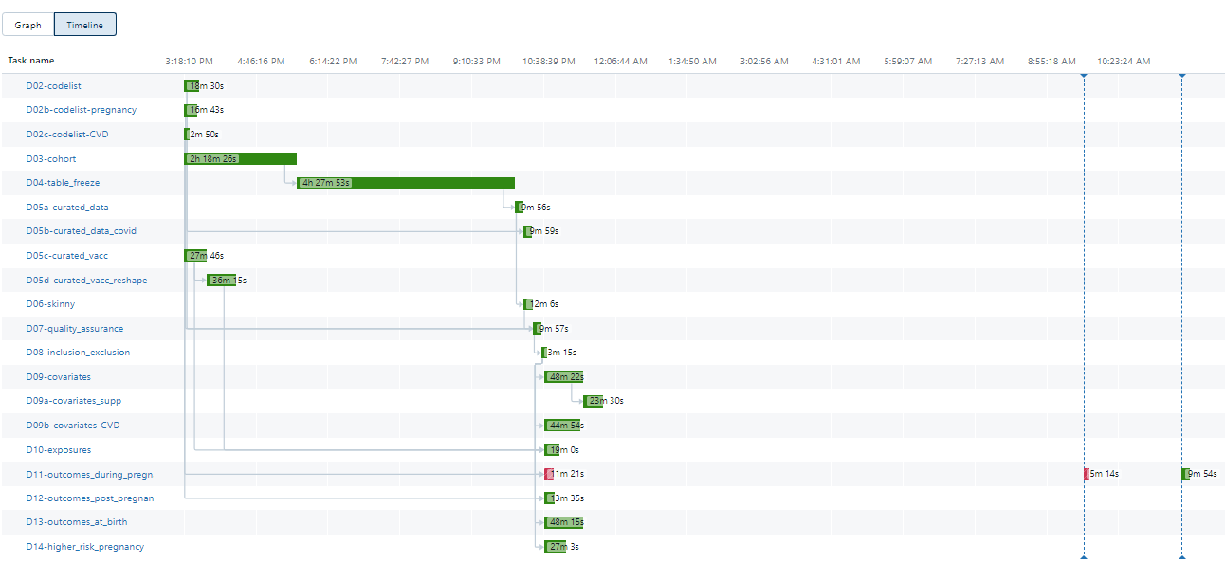
Also known as a pipeline!
My Notebook stage 1 ……………………………………….. Code code code code code Code code code code code Code code code code code Code code code code code Code code code code code ………………………………………… ………………………………………...
My Notebook stage 2 ……………………………………….. Code code code code code Code code code code code Code code code code code Code code code code code Code code code code code ………………………………………… ………………………………………...
My Notebook stage 3 ……………………………………….. Code code code code code Code code code code code Code code code code code Code code code code code Code code code code code ………………………………………… ………………………………………...
My Notebook stage 4 ……………………………………….. Code code code code code Code code code code code Code code code code code Code code code code code Code code code code code ………………………………………… ………………………………………...
Notes:
Instead, we therefore break up this code into several notebooks which might then be run in series.
To keep things simple, we tend to have a notebook for each distinct phase of the data curation, with data flowing into a notebook from the previous one, i.e. the outputs of notebook 2 are then the inputs of notebook 3.
We refer to this as a pipeline, and many people will be familiar with this.
This solves a lot of the previous problems. On the right-hand side, you can see the names of the notebooks that make up a pipeline which does all the curation work for a particular project in the consortium.

Slide 7
Then coordinating it through a “Master Notebook”
My Notebook stage 1 ……………………………………….. Code code code code code Code code code code code Code code code code code Code code code code code Code code code code code ………………………………………… ………………………………………...
My Notebook stage 2 ……………………………………….. Code code code code code Code code code code code Code code code code code Code code code code code Code code code code code ………………………………………… ………………………………………...
Master Notebook ………………………………………..
Run Notebook 1
Run Notebook 2
Run Notebook 3
Run Notebook 4
………………………………………… ………………………………………...
My Notebook stage 3 ……………………………………….. Code code code code code Code code code code code Code code code code code Code code code code code Code code code code code ………………………………………… ………………………………………...
My Notebook stage 4 ……………………………………….. Code code code code code Code code code code code Code code code code code Code code code code code Code code code code code ………………………………………… ………………………………………...
Notes:
The final ingredient of our conceptual pipeline is called a ‘Master Notebook’.
It can be frustrating to wait for one notebook to end so that you can run the next, especially if they take a while. Therefore, it makes sense to have a notebook that runs each of them for you automatically.
This is the function of the master notebook.

Slide 8
… which will run in sequence
My Notebook stage 1 ……………………………………….. Code code code code code Code code code code code Code code code code code Code code code code code Code code code code code ………………………………………… ………………………………………...
My Notebook stage 2 ……………………………………….. Code code code code code Code code code code code Code code code code code Code code code code code Code code code code code ………………………………………… ………………………………………...
Master Notebook ………………………………………..
Run Notebook 1
Run Notebook 2
Run Notebook 3
Run Notebook 4
………………………………………… ………………………………………...
My Notebook stage 3 ……………………………………….. Code code code code code Code code code code code Code code code code code Code code code code code Code code code code code ………………………………………… ………………………………………...
My Notebook stage 4 ……………………………………….. Code code code code code Code code code code code Code code code code code Code code code code code Code code code code code ………………………………………… ………………………………………...
Notes:
And if we look at the real-world pipeline we have on the right, we can see the order a master notebook would run them in.

Slide 9
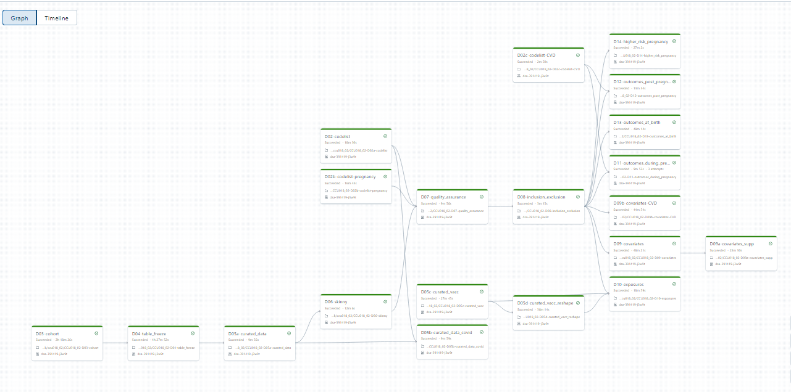
Pipeline as a Workflow Graph
Notes:
The previous system of using a master notebook makes a lot of sense for pipelines not designed to be run on a cluster.
Instead, we can use a feature of databricks called ‘Workflows’. This manages the running of the notebooks for us, and you can quickly see the advantages.
The workflow setup is illustrated in this graph, with dependency running from left to right. You can see some notebooks have nothing to the left of them, therefore they aren’t dependent on any others. This means that they could actually be run simultaneously, something that the master script can’t do. But running them in a cluster could save a lot of time.
The notebooks that make up this view can still be thought of as a pipeline, but for the rest of the presentation, as we’ll be using this workflow feature to coordinate them, I’ll refer to it as a workflow instead.

Slide 10
Workflow Results
This pipeline (workflow) took >8 hours to run
Notes:
In fact, when we run this workflow, we can see the timeline and make certain observations.

Slide 11
Workflow Results
This pipeline (workflow) took >8 hours to run
It would’ve been around 10 hours without some notebooks running in parallel

Slide 12
Workflow Results
This pipeline (workflow) took >8 hours to run
It would’ve been around 10 hours without some notebooks running in parallel

Slide 13
Workflow Results
This pipeline (workflow) took >8 hours to run
It would’ve been around 10 hours without some notebooks running in parallel
If we make changes or fixes, we only need to rerun the affected notebook or those downstream (10 mins is better than 8hr)
Notes:
This is an important point. While a master script or a workflow is helpful for running a pipeline end to end, sometimes we’re only making changes part way through. So, one way to preserve computational resource is to only rerun the affected notebook (and any downstream of it).
How you do this may depend on how long you expect it to run and the need for scheduling. We’ll come back to this later.

Slide 14
Workflow Results
This pipeline (workflow) took >8 hours to run
It would’ve been around 10 hours without some notebooks running in parallel
If we make changes or fixes, we only need to rerun the affected notebook or those downstream (10 mins is better than 8hr)
Over 4 hrs, half the runtime, is due to one notebook. We’ve identified a bottleneck!
Notes:
With the bottleneck identified above, if we wanted to try to improve the runtime of our workflow, ‘D04_table_freeze’ would be an excellent place to start.

Slide 15
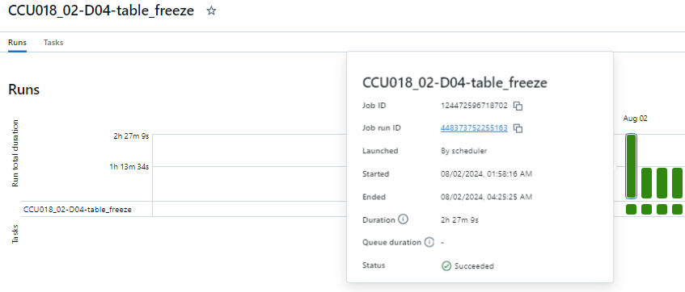
Tackling the bottleneck
Notes:
So, lets treat this notebook as a case study. We’re aware the runtime is suspiciously long – 4hours from an 8-hour workflow.

Slide 16
Tackling the bottleneck
Half the notebook runtime just by running it off-peak
Notes:
For this notebook I only took two approaches to improve it.
Knowing I would need to test each change, I set it to run in the middle of the night (around 2am) to avoid disrupting others. But scheduling it to run at this hour nearly halved the runtime itself. You can see it’s now taking 2.5 hours rather than the original 4 hours.

Slide 17
Tackling the bottleneck
Half the notebook runtime just by running it off-peak
Half again just changing one line of code to a more cluster friendly function (‘broadcast’)
Notes:
For the second improvement, we were aware that some code is more cluster friendly than others. In this case, I can use an alternative join function called ‘broadcast’.
An analogy for this might be… imagine you’re going grocery shopping in a team. You only have one shopping list, so after each errand every team member must return to a central point to check the list. Broadcast is the equivalent of giving a copy of the list to each team member.
Not a perfect analogy but you get the idea. We’re gradually learning more and more which kinds of functions and practices are cluster friendly, and more importantly which to avoid.
Simply changing that one function in one line of code halved the runtime again to 1.25 hours.

Slide 18
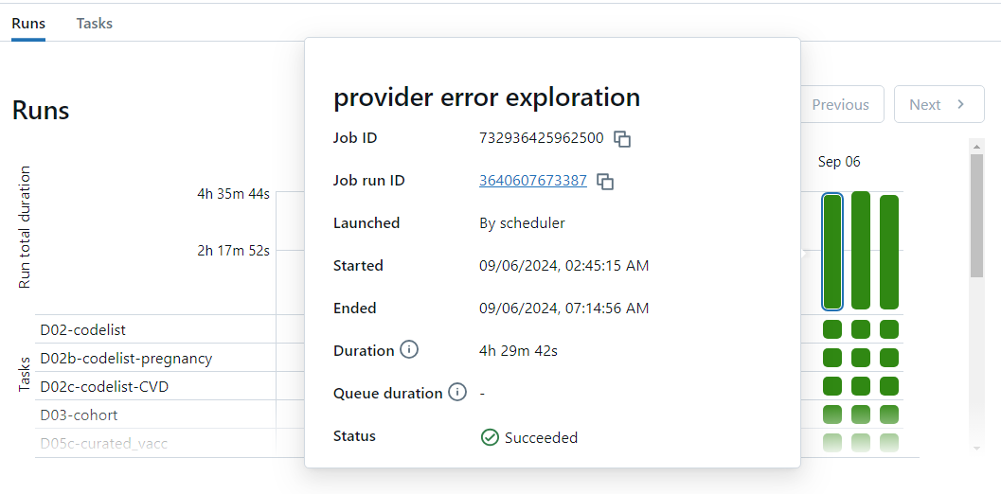
Back to the overall pipeline – was it worth it?
Notes:
So, we’ve successfully cut the runtime of that notebook considerably, but how does this affect the overall runtime of the whole pipeline?
As expected, we’ve cut nearly 4 hours off it. Simple coding modifications and sensible scheduling has been a big win.
In reality, although these were only small changes, the exploration did take a bit of time. So, it’s fair to ask ourselves if the payoff was worth it as at the time this was undertaken it seemed like the project curation was completed.
As it happens, and inevitably it always does, we discovered some data issues in the analysis that meant the workflow did need to be rerun several times. Not only that but there’s another iteration of this project planned, so implementing the changes here will benefit the future project.
So, in simple maths, around 4 hours was spent to save 4 hours of a single pipeline. But given how many times we’re rerunning this will pay off again and again and again. I believe it is therefore always worth optimising in this kind of situation.

Slide 19
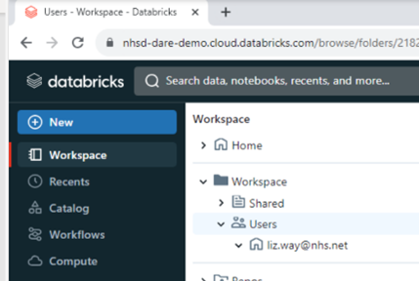
Key take home points
1
Notes:
So, for the time being I’d like cluster users to consider the following take home points. Firstly – exploring and adopting the ‘workflows’ feature of databricks.

Slide 20
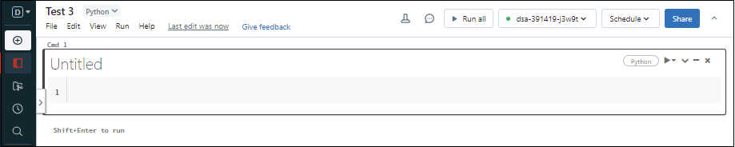
Key take home points
1
2
Notes:
Secondly – scheduling notebooks or workflows to run at off-peak hours where possible. A good rule of thumb is if it takes more than an hour, consider running late in the evening/at night….. And if it’s more than 4 hours, consider running it on a weekend instead.

Slide 21
Key take home points
1
3
2
Notes:
The third is about what you choose to run and how. Which notebooks can run in tandem? Which might not need to run at all (recall our point about only rerunning notebooks you’re changing and those downstream)?

Slide 22
Key take home points
1
4
3
2
Notes:
Fourth – be on the lookout for bottlenecks! Are notebooks or pipelines taking a disproportionate amount of time to run?
It can be hard to know what's normal and what’s suspicious. Please do reach out to us on this if you’re unsure.

Slide 23
Key take home points
Start using Workflows to optimise your pipeline
Schedule tasks during off-peak hours
Avoid running notebooks that aren’t needed
Identify onerous runtimes and bottlenecks

Slide 24
Anything else?
We’ll look to release further guidance on optimising code
(eg ‘broadcast’, ‘checks_on’, ‘limit(100)’ , etc etc)
Please do get in touch for support - bhfdsc_hds@hdruk.ac.uk
… and also to contribute! We know many will have great ideas and tips of their own
We’re sharing a common resource so there are both selfless and selfish reasons to be as efficient as possible with compute
Notes:
This was all very topline, and we know many of you will want more detailed guidance. We’ll do our best to provide this shortly.
In the meantime, please do reach out with questions, and likewise we’re keen to crowdsource suggestions on how to optimise and build up a community resource.
Don’t forget that by sharing tips you’ve learned to make your own notebooks run faster you’ll free up more resource if others can follow your approach. A real win-win opportunity. Or given how many of us are using the cluster, and how many runs we each do this would be win-win-win-win-win-win-win …. Etc etc!
Many thanks
Health Data Scientist Team <bhfdsc_hds@hdruk.ac.uk>

